Slide 1
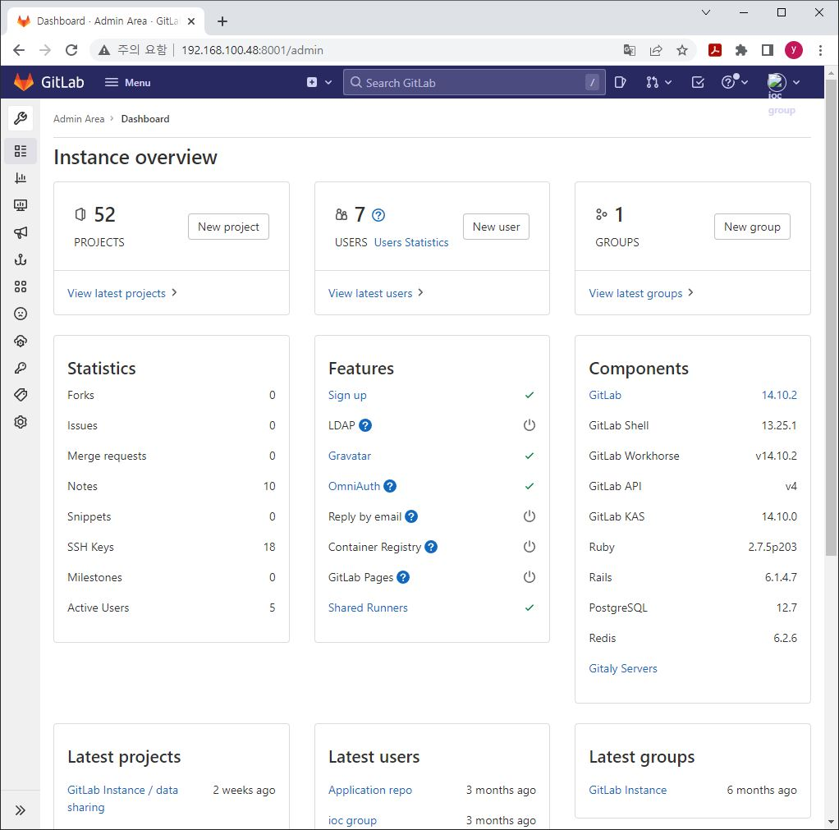
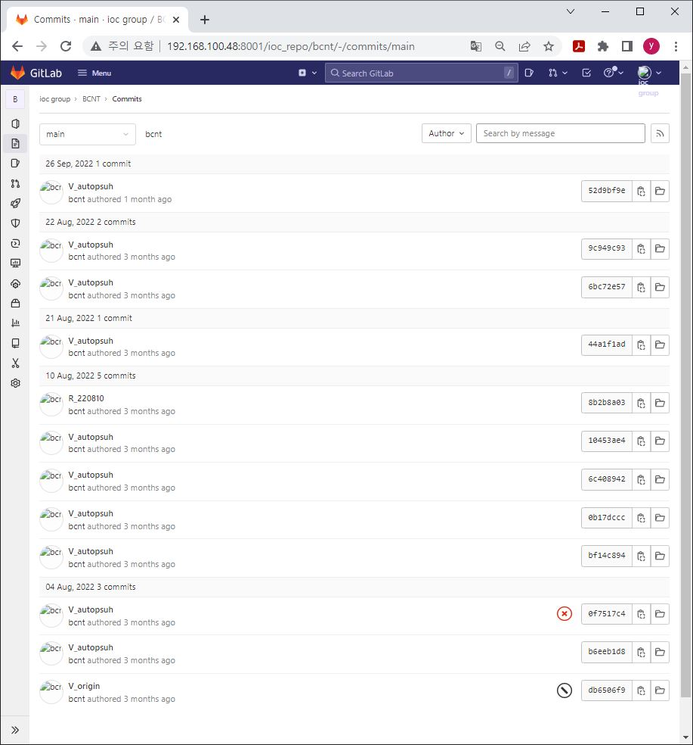
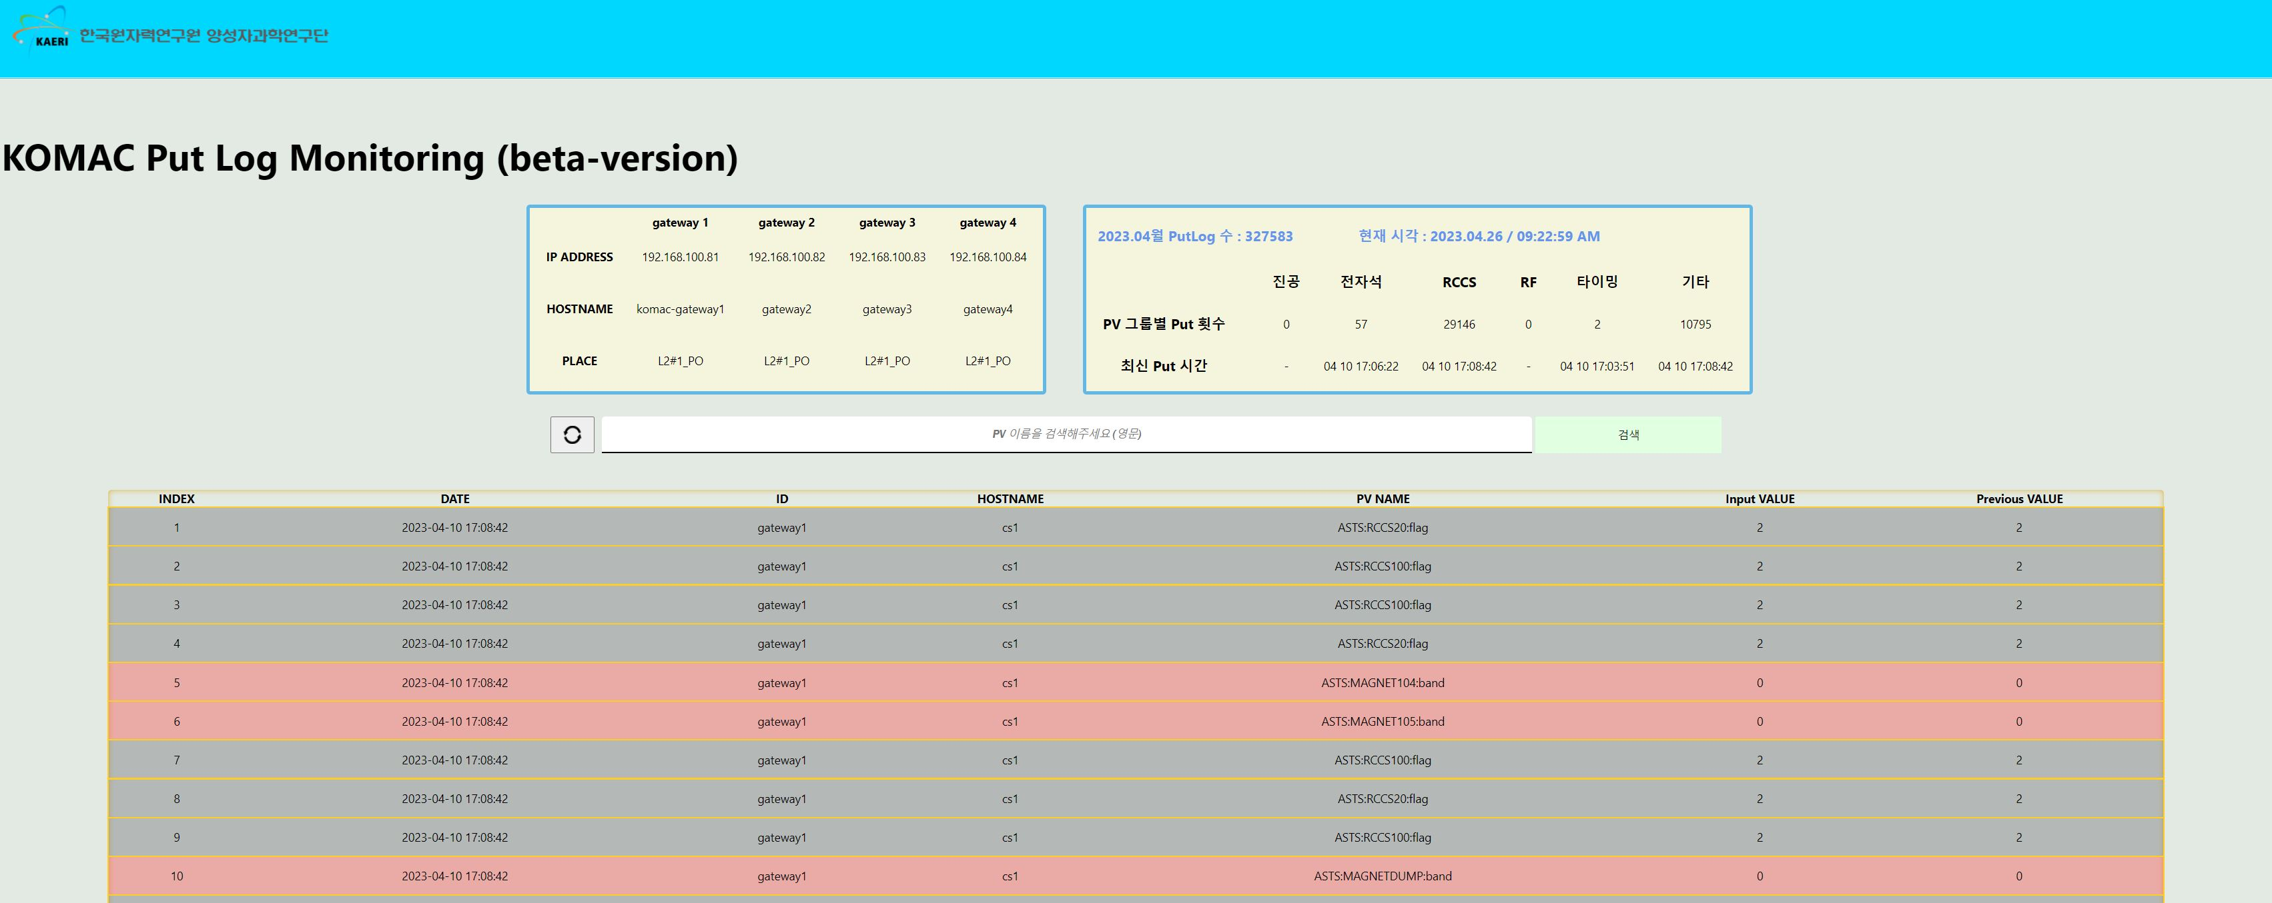
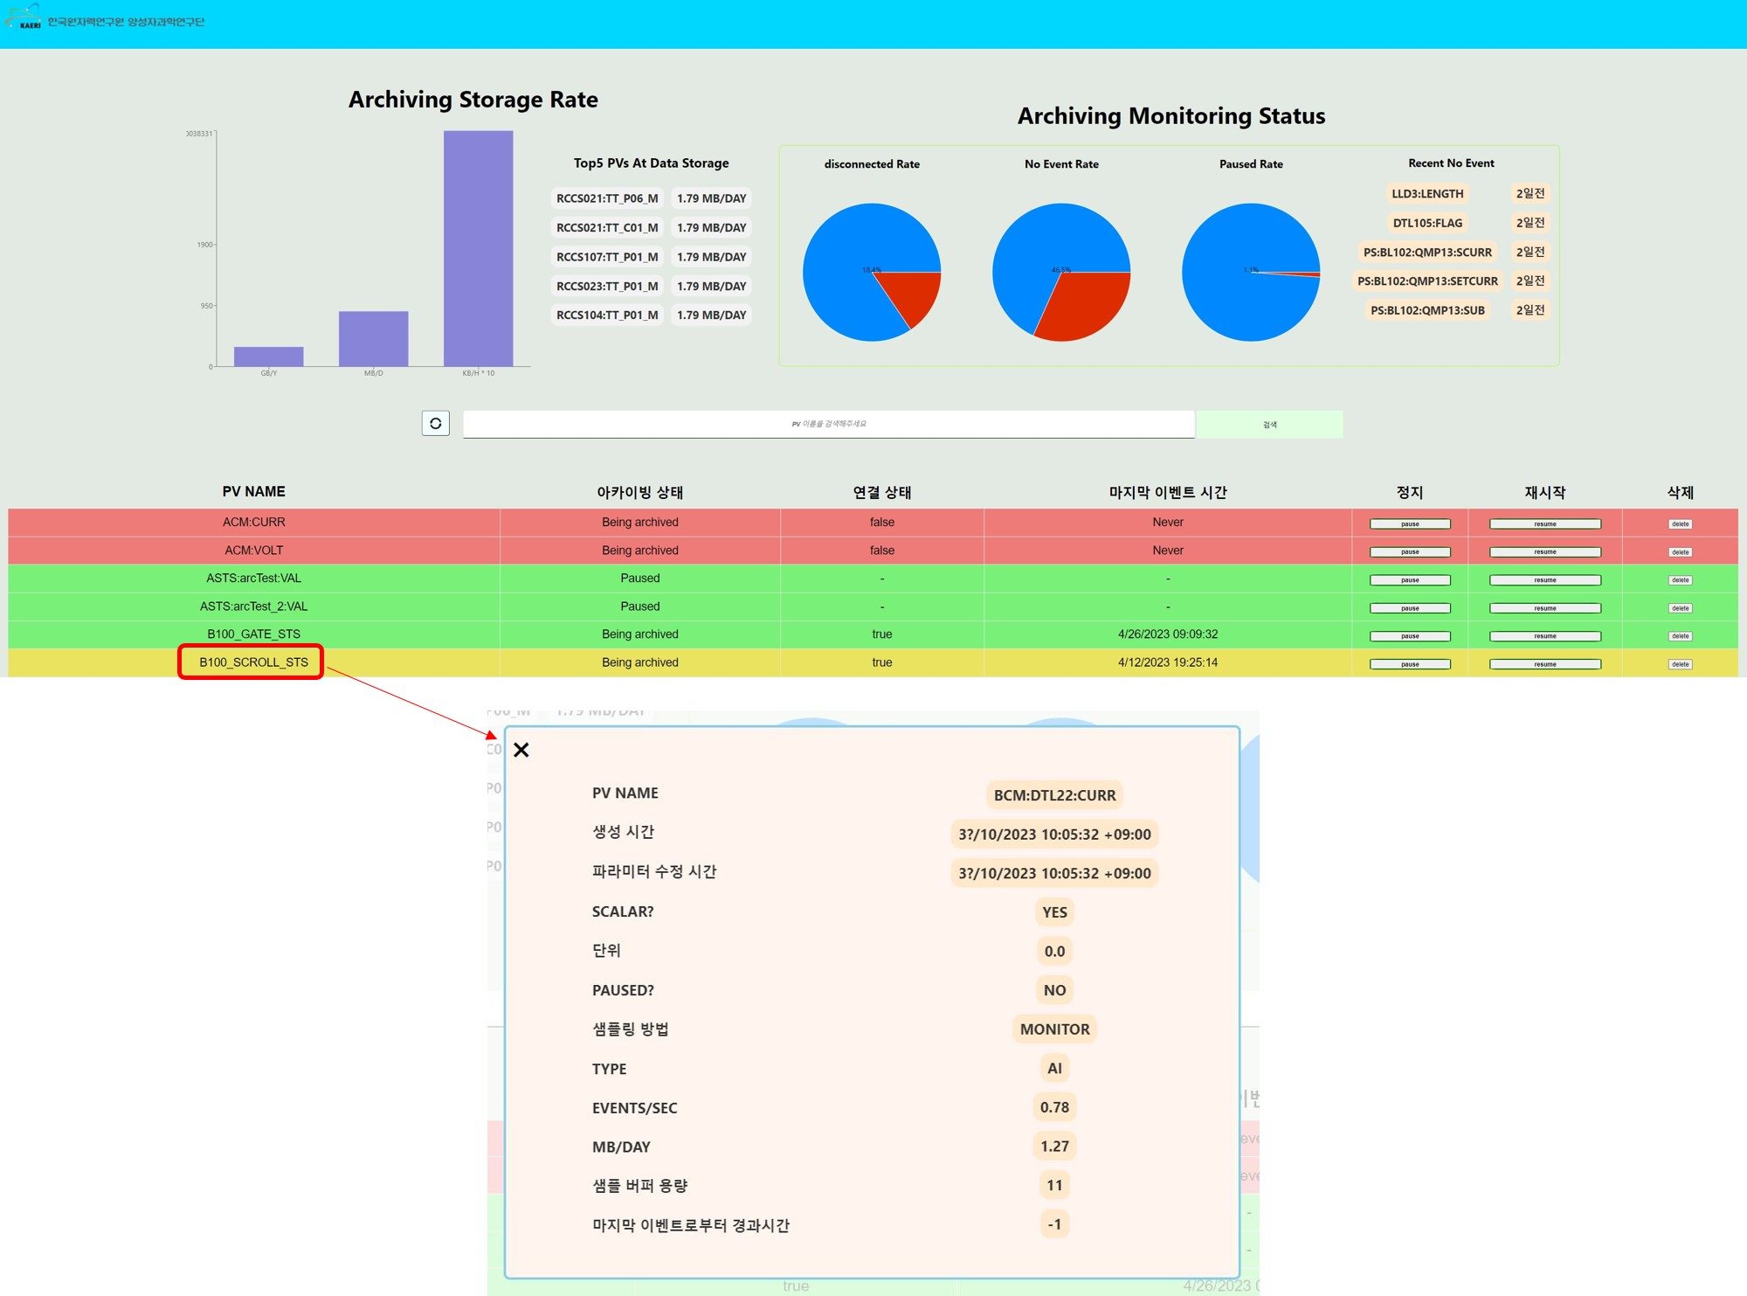
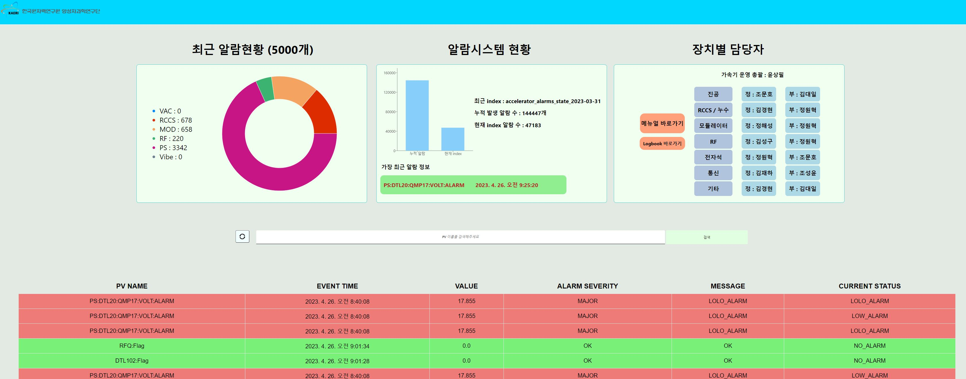
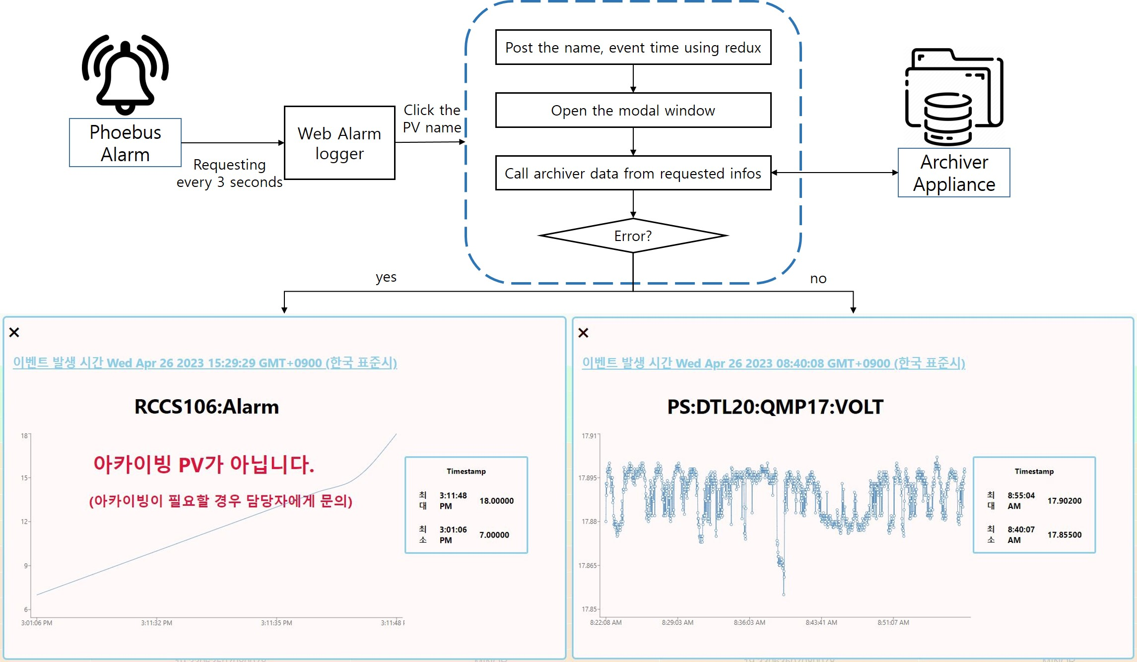
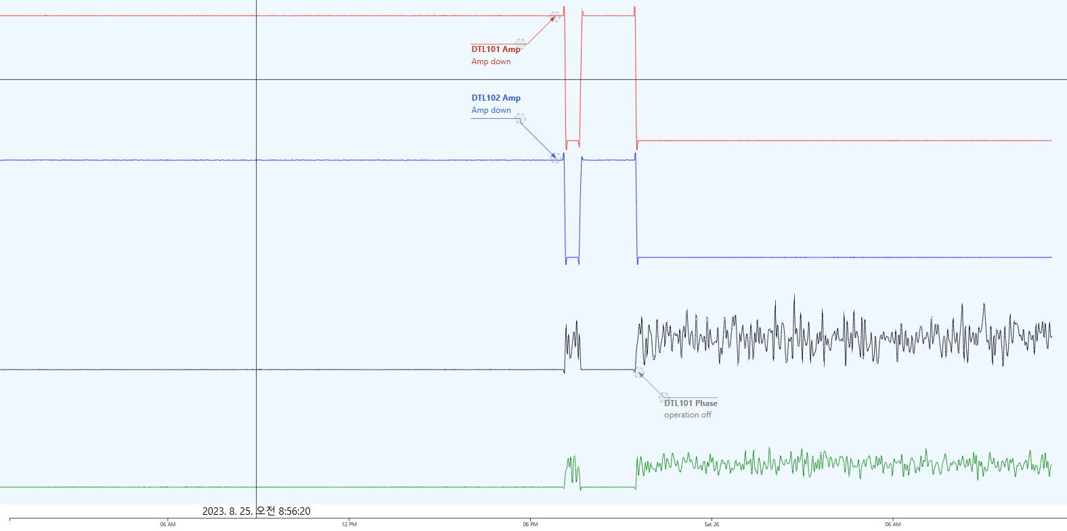
Design of the web Application for improving the management of the data at KOMAC
Sung-yun Cho#, Jae-Ha Kim, Young-Gi Song, Hyeok-Jung Kwon
Korea Multipurpose Accelerator Complex, Korea Atomic Energy Research Institute., Gyeongju, Korea
* This work has been supported through KOMAC (Korea of Multi-purpose Accelerator Complex) operation fund of KAERI by MSIP (Ministry of Science, ICT and Future Planning)
# sungyun@kaeri.re.kr
The control system and web service for KOMAC
Network Management System
Timing Synchronization & Timing System
Machine Protection System
User Interface
Abstract :
A control system based on Experimental Physics and Industrial Control System (EPICS) has been implemented for the 100 MeV linear proton accelerator at the Korea Multi-purpose Accelerator Complex (KOMAC). Our control system is operated with over 20,000 Process Variables (PVs) and utilizes several services such as Phoebus alarm, Archiver Appliance and, Channel Access gateway, among others. The data, which includes the PVs value and the logs of service, need to be managed to identify the status of system. A web application has been developed using React and Elasticsearch, Logstash, Kibana, and Filebeat (ELK+Filebeat). we introduces the web services for archiving service logs. In addition, the data analysis web application is also introduced that we are developing using React with D3 library.
CSS
MEDM
PYDM
WEB
routes
Control Network
Timing Network
Control System
EPICS CA Gateway
Alarm System
Interlock Network
API
Vacuum
Gateway 1
Alarm
Handler
BEAST
Power supply
Gateway 2
Archive system
LLRF
Gateway 3
Archive
Appliance 1
Archive
Appliance 2
RCCS
Gateway 4
Ion Source
Web Server
GitLab
Data collection
Beam Current Monitor
Web Service
Main server
Mirror server
Beam Position Monitor
Data Management & Processing
IOC
Event Timing
ELK
( log collector )
High level application
Modulator
PV monitoring
(CA node js)
RF Scan & Analysis
IOC
IOC
LEBT Scan
Wire Scan
The web architecture for KOMAC
The architecture of KOMAC Control System
The KOMAC web services
The GitLab (auto backup)
The Input and Output Controllers (IOCs) are managed and versionized automatically using git.
When the IOC is started, the local repository is automatically committed and push the information to remote repository.
The channel access gateway Putlogger
We are operating the four CA gateway to providing stable traffic. Each gateway has a log file that’s written about input information.
The system log files can be gathered by ElasticSearch, Logstash, and Kibana (ELK) and the user can search the information on the ElasticSearch through the web service page.
Gateway 1
filebeat
PutLog archiving engine (backend)
Gateway 2
putlog
Gateway 3
putlog
Parse, filter, transform
Gateway 4
putlog
Data management
putlog
Control Network
Log Archiving
The management service for archiver appliance
We have developed a management page using the API provided by the EPICS archiver appliance.
Users can quickly notice the monitoring status and storage rate.
The status is differentiated by colors.
When a user clicks on the PV name, a modal window pops up to display detailed information.
The alarm logger on the web
The KOMAC alarm system is implemented using the Phoebus alarm system.
The Phoebus alarm system logs the alarm information using ELK.
We developed the monitoring page for checking immediately alarm data.
When the alarm occurs, the operator just click the name and the modal window will be opened with the archiving data from 1 hours.
Zoom in /out event
(mouse wheel)
Raw data :
X : time stamp
Y : values
DEMO
The data analysis service using D3 library (on developing)
We are developing the data analysis tool on web using the D3 library.
It is connected with the EPICS archiver appliance.
Our goal is to provide this tool with powerful data processing capabilities such as cs-studio, while also offering an intuitive and convenient analysis environment, akin to stock chart analysis tools.
If the zoom event is detected, the sequence of adjusting sampling starts.
Users can analyze the system parameters with simple annotation
Calculate the average, deviation…
Find the timestamp(x) at the current zoom status
Length > 2000?
no
Draw the line graph
Export Idx info
(str and end point)
yes
Slice the raw data(y) using idx info
Adjust the data size (max size = 2000)

